Slide 1
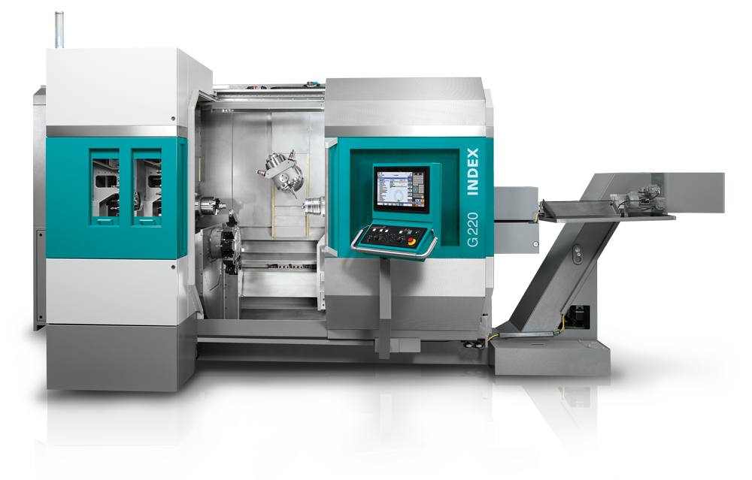
Using Time Series Forecasting Techniques to Predict Future Tool Wear Events
COM748 ( 18554 ) - Masters Project. 2021-22.
Rebecca Nixon
Dr Joe Rafferty

Slide 2
Presentation Overview
Project Introduction
Literature Review
Methodology and Theory
Results and Discussion
Conclusion
Future Work
Questions

Slide 3
Background
&
Introduction

Slide 4
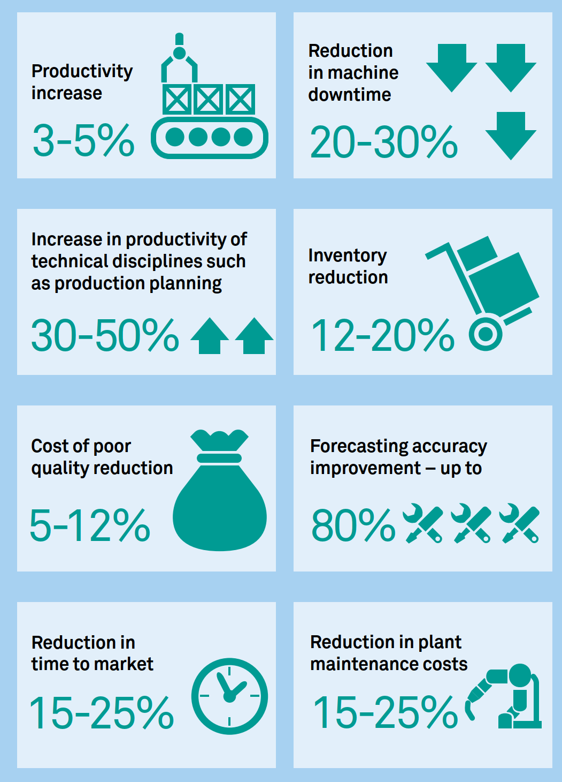
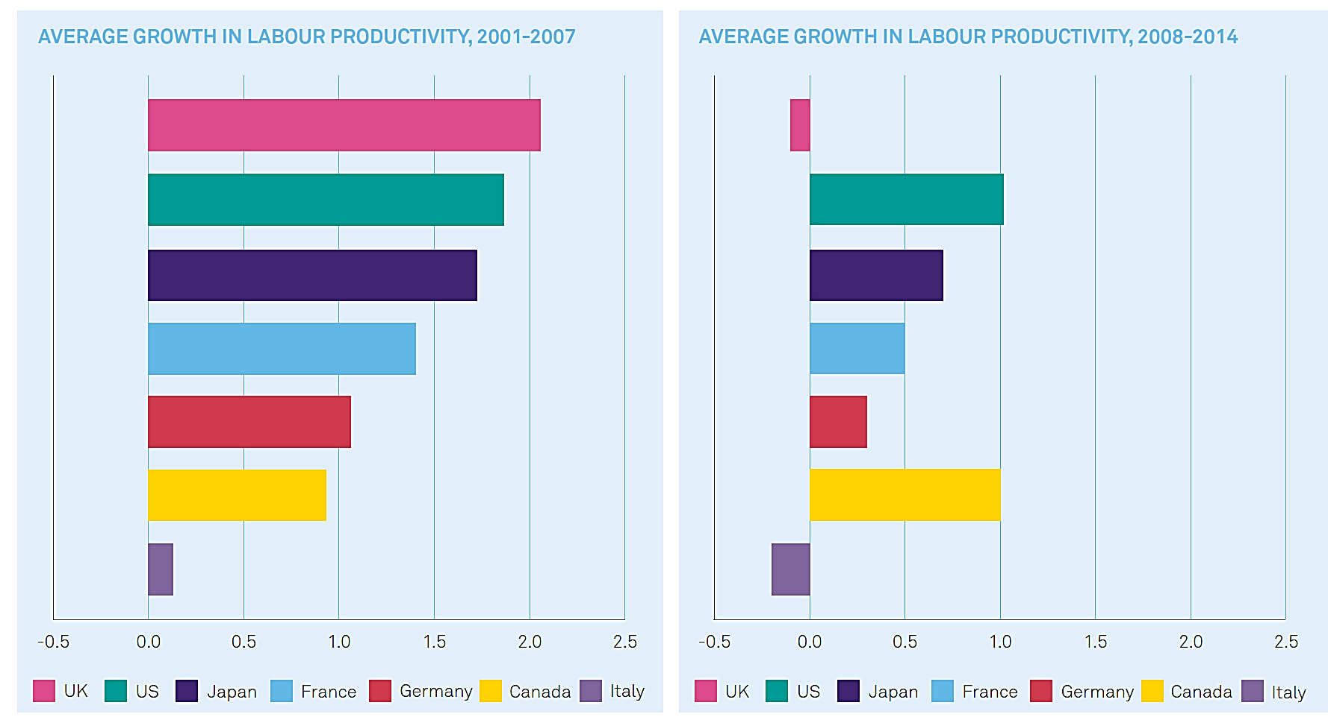
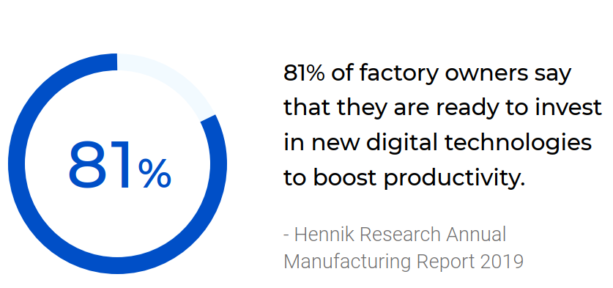
Introduction
Background to problem
1
1
2
https://assets.publishing.service.gov.uk/government/uploads/system/uploads/attachment_data/file/655570/20171027_MadeSmarter_FINAL_DIGITAL.pdf
https://www.madesmarter.uk/media/zooczmkg/connected_factory_report-final.pdf
Notes:
In 2017, with the Made Smarter Review, the UK industry answered the call of government to set out a vision for growth and increased productivity across the manufacturing sector. They highlighted the benefits of unlocking the potential of Industrial Digital Technologies (IDTs) or as we know it Industrial Internet of Things (IIoT).
81% of factory owners say they are ready to invest in new IDTs but there are many barriers to adoption. Two of the main barriers were:
Lack of time – 26% of companies
Equipment costs – 45% of companies

Slide 5
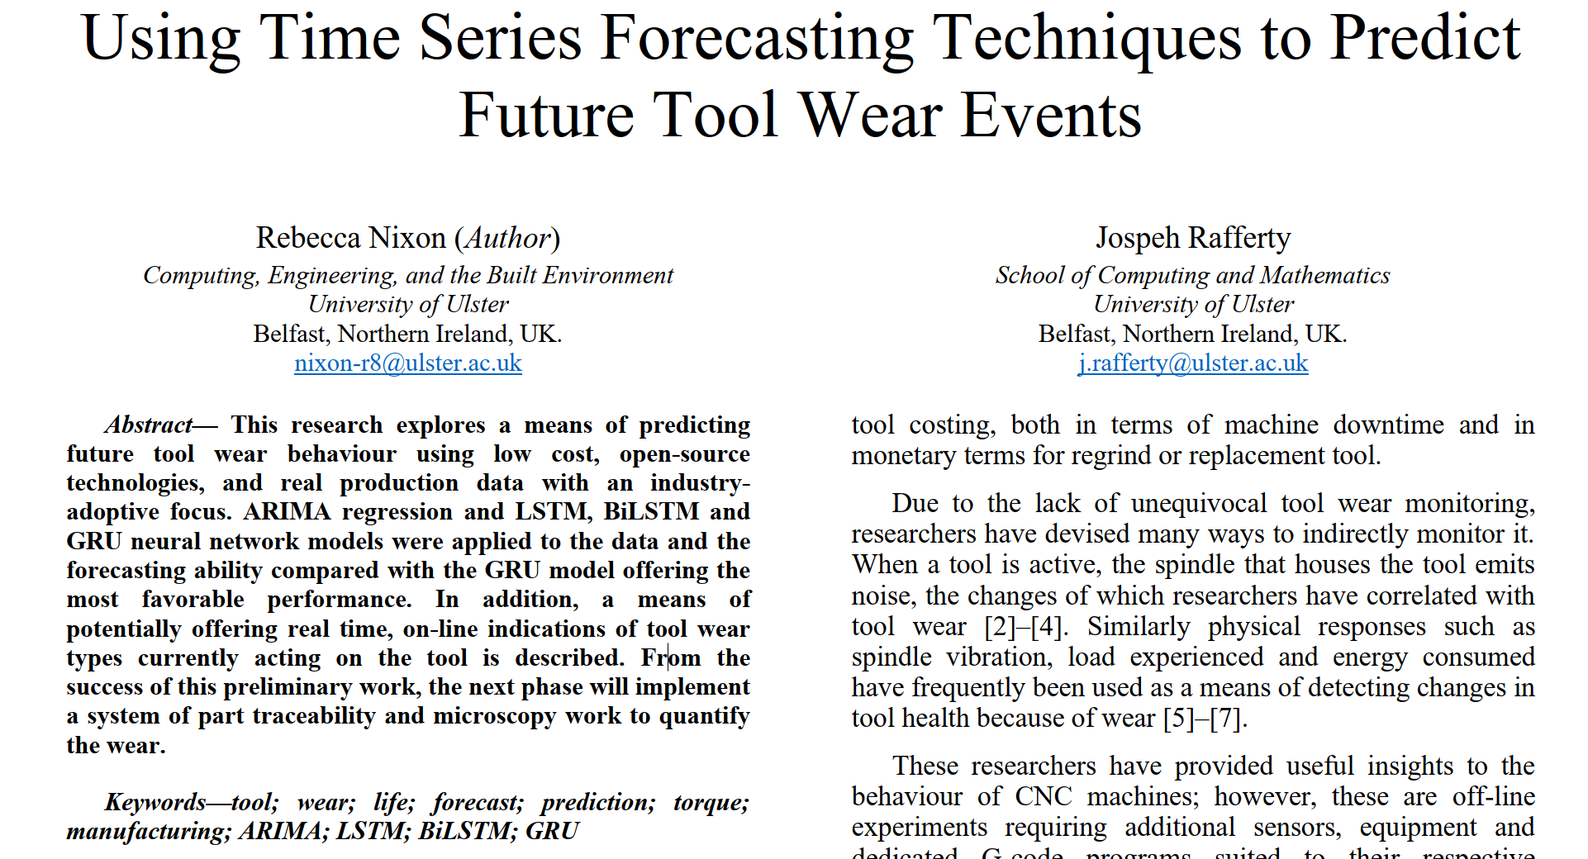
Introduction
What’s the project?
Notes:
This research explores a means of predicting future tool wear behaviour that would impact wear rate and, therefore so to, the life of the tool. The methodology consists of a low cost, open-source, and non-intrusive method of monitoring machine production processes. The analysis utilizes machine learning algorithms to attempt to predict and forecast future machine parameters linked to tool wear of a Gundrill. The eventual goal is to accurately forecast this tool behaviour on-line, in real time, forecasting tool wear events which can be avoided through pre-emptive remedial action.

Slide 6
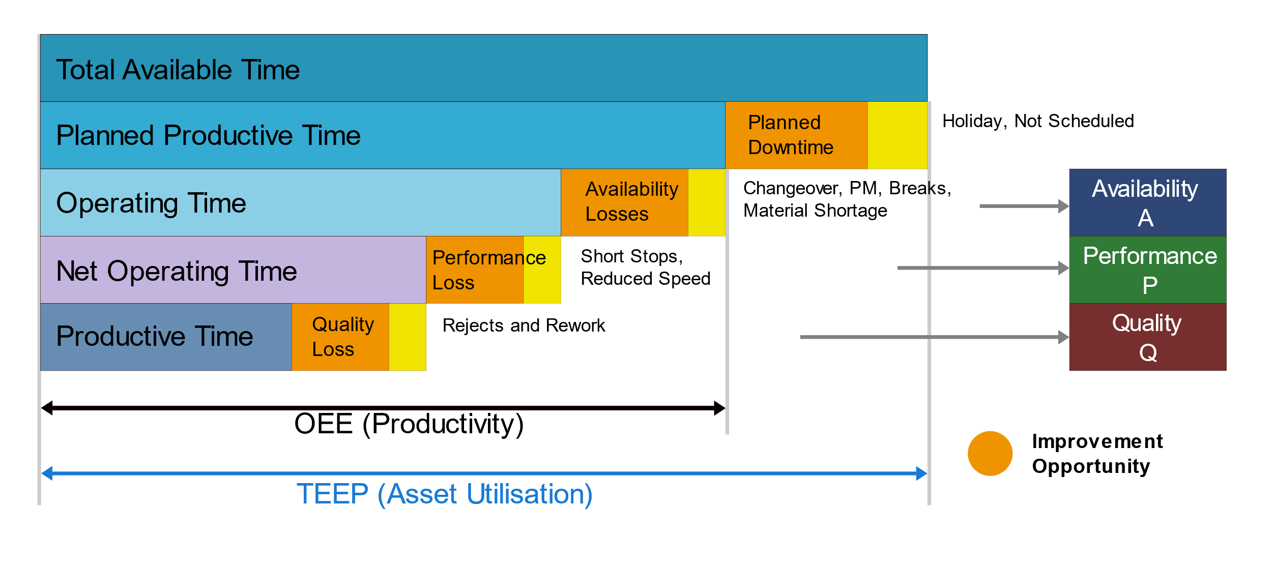
Introduction
Why Tool Wear?

Slide 7
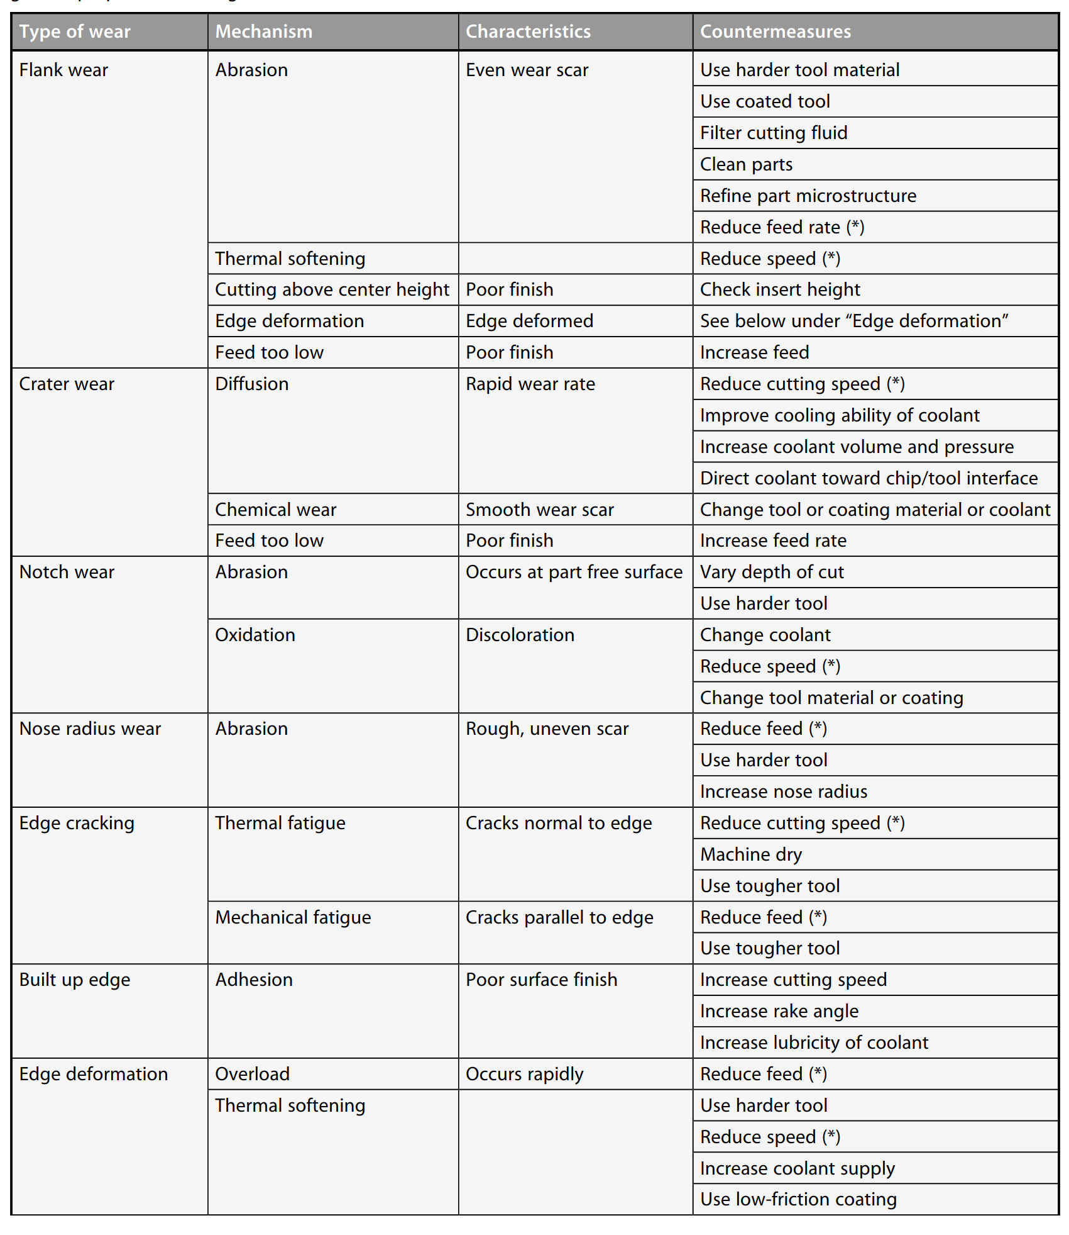
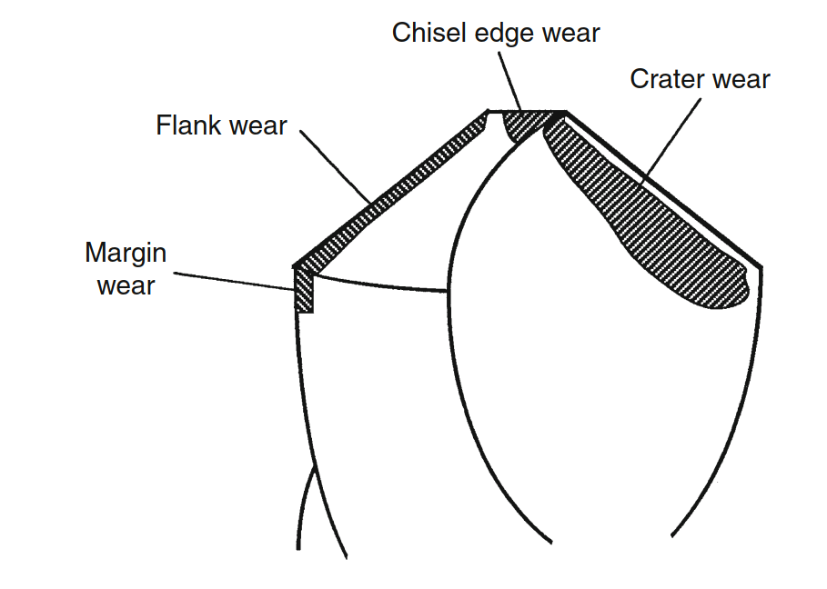
Introduction
What is Tool Wear?
J. Agapiou and D. A. Stephenson, “Cutting Tool Wear and Failure Mechanisms,” in Encyclopedia of Tribology, Springer US, 2013, pp. 661–677.

Slide 8
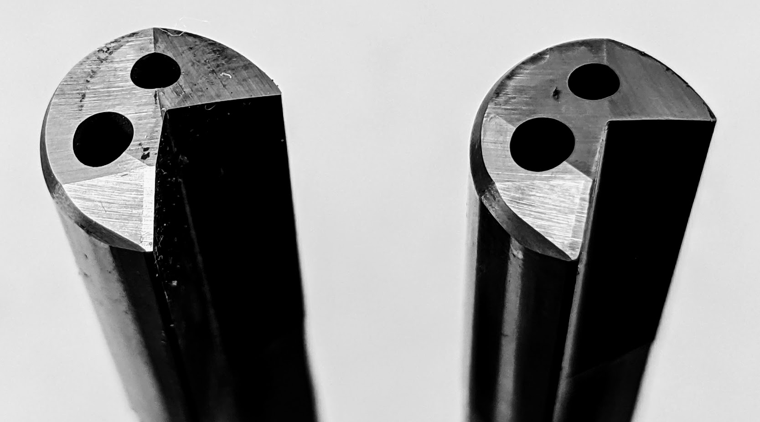
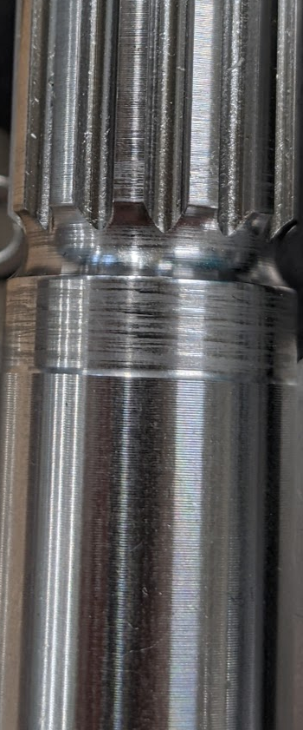
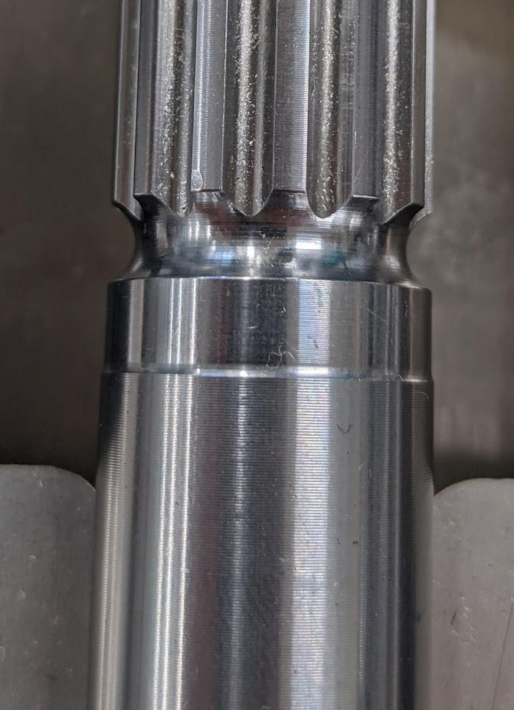
Introduction
What’s the focus?
Effect of wear on Gundrill
Effect of wear on part finish

Slide 9
Literature Review
What have others done?
Authors | Research | Ref
A. Gouarir et al. | In-process flank wear prediction system Used a force sensor to monitor progression of tool flank wear. Converted each Fx, Fy, Fz force into an image for CNN modelling. Classified wear into 3 categories with 90% accuracy | 1
Ammouri & Hamade | Process-independent criterion for diagnosing tool condition Based on calculating the percent increase of RMS measured current values of the spindle and drive motors of the machine tool Used polar maps to indicate wear breaching desirable regions | 2
Xi et al. | Real-time tool monitoring using internal machine data Infers wear from forces indirectly calculated from motor current Uses collected data to create virtual model and of workpiece through which virtual quality data is extracted and tool wear estimated “reliability of the developed system can be improved” | 3
Seemuang, McLeay & Slatter | Explored inexpensive & non-intrusive method of inferring tool condition by measuring the audible sound emitted during machining. Audio signal was compared to the flank wear development for different surface speed and cutting feed combinations. No relationship between the frequency of spindle noise and tool wear Magnitude of spindle noise affected by varying RPM and FR, which is related to tool wear. | 4
[1] A. Gouarir, G. Martínez-Arellano, G. Terrazas, P. Benardos, and S. Ratchev, “In-process Tool Wear Prediction System Based on Machine Learning Techniques and Force Analysis,” Procedia CIRP, vol. 77, pp. 501–504, Jan. 2018, doi: 10.1016/J.PROCIR.2018.08.253.
[2] A. H. Ammouri and R. F. Hamade, “Current rise criterion: A process-independent method for tool-condition monitoring and prognostics,” Int. J. Adv. Manuf. Technol., vol. 72, no. 1–4, pp. 509–519, 2014, doi: 10.1007/S00170-014-5679-9.
[3] T. Xi, I. M. Benincá, S. Kehne, M. Fey, and C. Brecher, “Tool wear monitoring in roughing and finishing processes based on machine internal data,” Int. J. Adv. Manuf. Technol., vol. 113, no. 11–12, pp. 3543–3554, Apr. 2021, doi: 10.1007/S00170-021-06748-6/FIGURES/13.
[4] N. Seemuang, T. McLeay, and T. Slatter, “Using spindle noise to monitor tool wear in a turning process,” Int. J. Adv. Manuf. Technol., vol. 86, no. 9–12, pp. 2781–2790, Oct. 2016, doi: 10.1007/S00170-015-8303-8.
Notes:
[1] – Costly, complicated and labour-intensive
[2] – Off-line and incredibly complicated without obvious, quantitative indications of comparative success
[3] – Pretty neat but overly complicated for goal. Lots of outliers and need for constant checking of tools. Early days and reliability needs improved. Likely a project where tool monitoring was an add-on for a digital twin project.

Slide 10
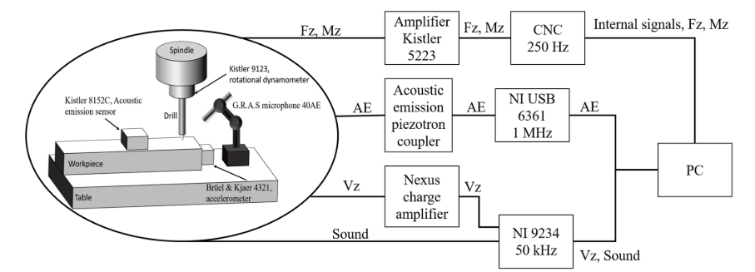
Literature Review
What’s the frustration with their work?
A. Duo, R. Basagoiti, P. J. Arrazola, J. Aperribay, and M. Cuesta, “The capacity of statistical features extracted from multiple signals to predict tool wear in the drilling process,” Int. J. Adv. Manuf. Technol., vol. 102, no. 5–8, pp. 2133–2146, Jun. 2019, doi: 10.1007/S00170-019-03300-5.
Notes:
All literature encountered thus far has been a combination or either or both of:
Off-line in that there were scientific experiments: specific tests in repetitive replicable conditions, bespoke to the experiments
Requiring bespoke expensive equipment
Either way, they have been less adoptable by industry than would be preferred, by industry.

Slide 11
Methodology & Theory
What are you doing differently?
Production CNC
machine
Internal data extraction
Data Analysis
Neural Network
Time series forecasting
Traditional Method
ARIMA
LSTM
BiLSTM
GRU

Slide 12
Methodology & Theory
What are those methods?
ARIMA
AR I MA
AutoRegressive
Integrated
Moving Average

Slide 13
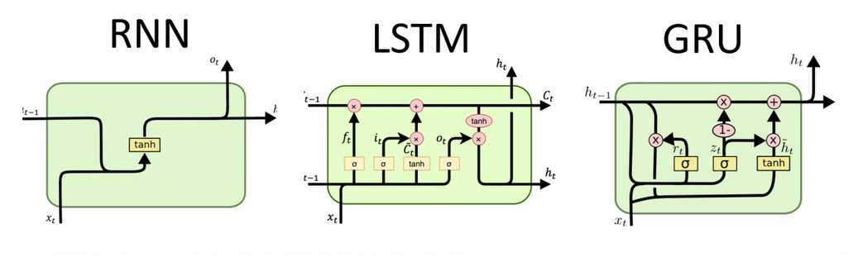
Methodology & Theory
What are those methods?
LSTM and GRU
http://dprogrammer.org/rnn-lstm-gru

Slide 14
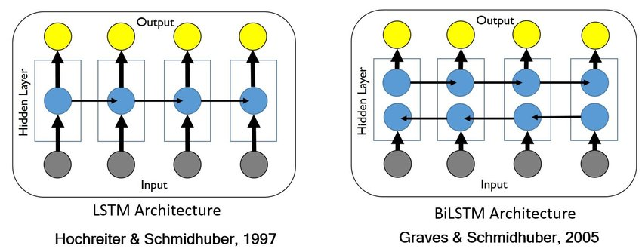
Methodology & Theory
What are those methods?
BiLSTM
A. T. Mohan and D. V. Gaitonde, “A Deep Learning based Approach to Reduced Order Modeling for Turbulent Flow Control using LSTM Neural Networks,” Apr. 2018, Accessed: May 13, 2022. [Online]. Available: http://arxiv.org/abs/1804.09269.

Slide 15
Methodology & Theory
How?
OPCUA
Open Platform Communications Unified Architecture.
Machine-to-machine communication protocol for industrial automation
Message Queuing Telemetry Transport
Extremely lightweight publish/subscribe messaging protocol for IoT
Open-source server agent
Facilitates collection of metrics from stacks, sensors and systems.
Open-source time series database developed by InfluxData.
Optimised for fast, high-availability storage and retrieval of time series data for analytics.
Multi-platform, open-source analytics and interactive visualisation application.
Provides charts, graphs, and alerts when connected to supported data sources.
MQTT
Telegraf
Influx DB
Grafana
Notes:
How can the data be accessed in the first place? There are a few methods through which this can be achieved but in this case it was done by using the Open Platform Communications United Architecture. Whilst often labelled a protocol, OPC UA is more than that, it is a framework for industrial interoperability with common data models so that machines which can communicate in many ways aren’t locked-in to those specific protocols such as Profibus or EtherCat. All machines can be catered for by OPCUA.
Data then enters the TIG stack through the Telegraf agent which subscribes to the topics of interest and in turn pushes this data to Influx DB. The data can be visualised on Grafana for instant insights to production.

Slide 16

Methodology & Theory
How?
Company Network
rPi4
Docker
Index
G220
OPCUA Server
Python Script
Telegraf
Influx DB
MQTT Broker
OPCUA Client
MQTT Connector
Grafana

Slide 17
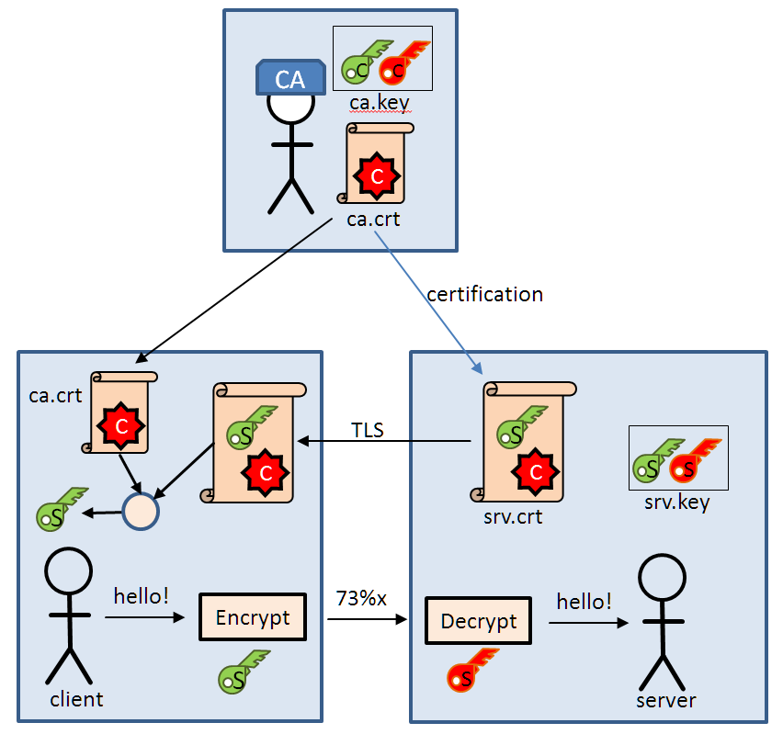
Methodology & Theory
Security
MQTT TLS Encryption
&
User Authentication
Notes:
But if anything can subscribe as long as it has MQTT, how can data integrity be ensured and security maintained?
The answer to this is Transport Layer Security (TLS) certificates and user authentication.
TLS, also known as SSL, or Secure Sockets Layer, is essential to securing internet browser connections and transactions through data encryption.
The user authentication, ie username and password is to ensure credible users to begin with. Each user has access to certain topics, the discretion lying with the system administrator.

Slide 18
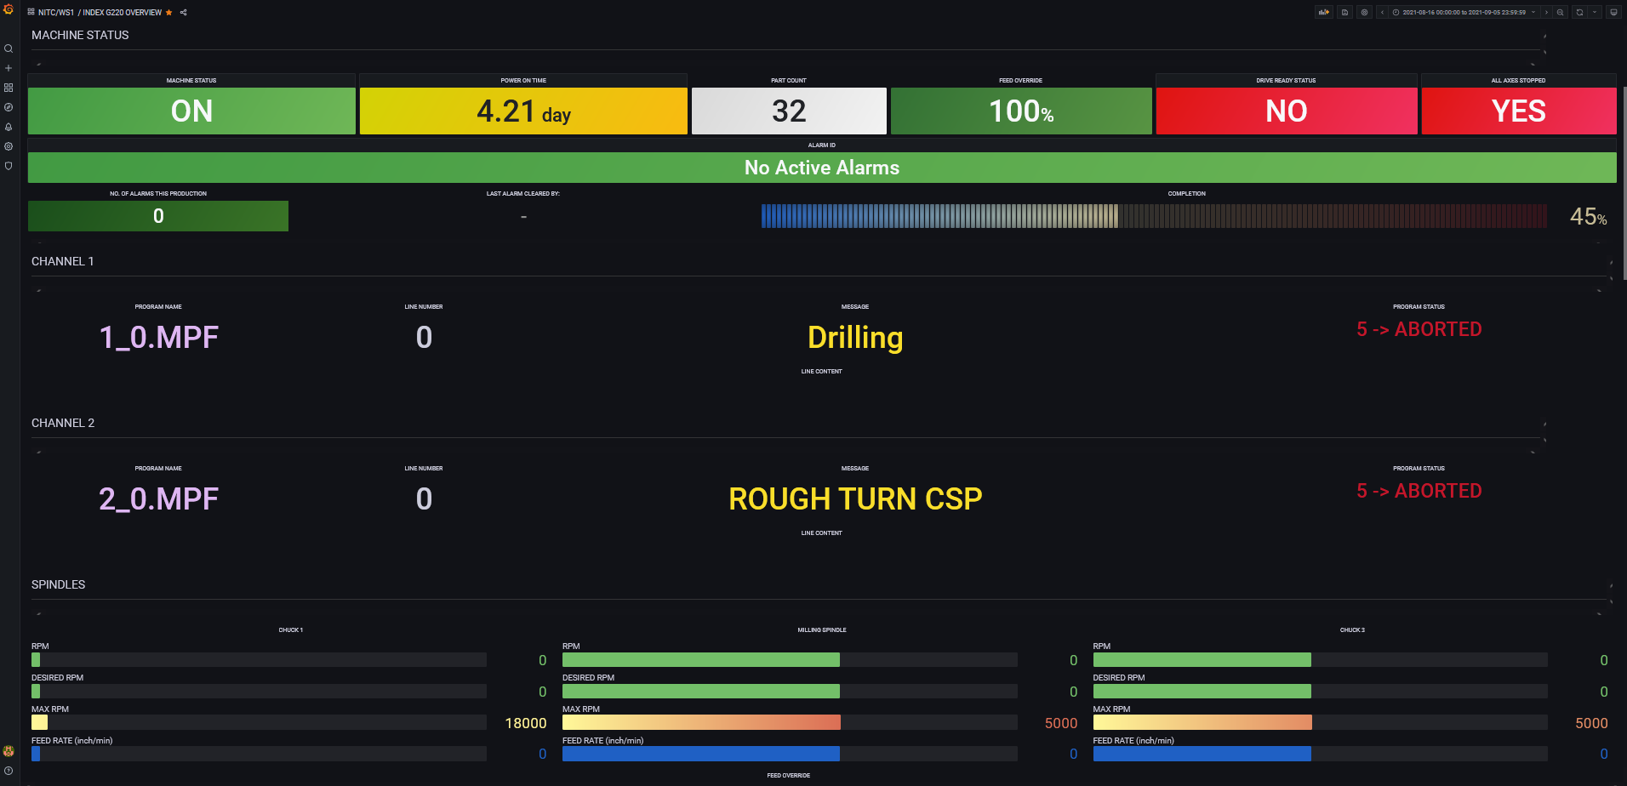
Methodology & Theory
Example dashboard (Grafana)

Slide 19
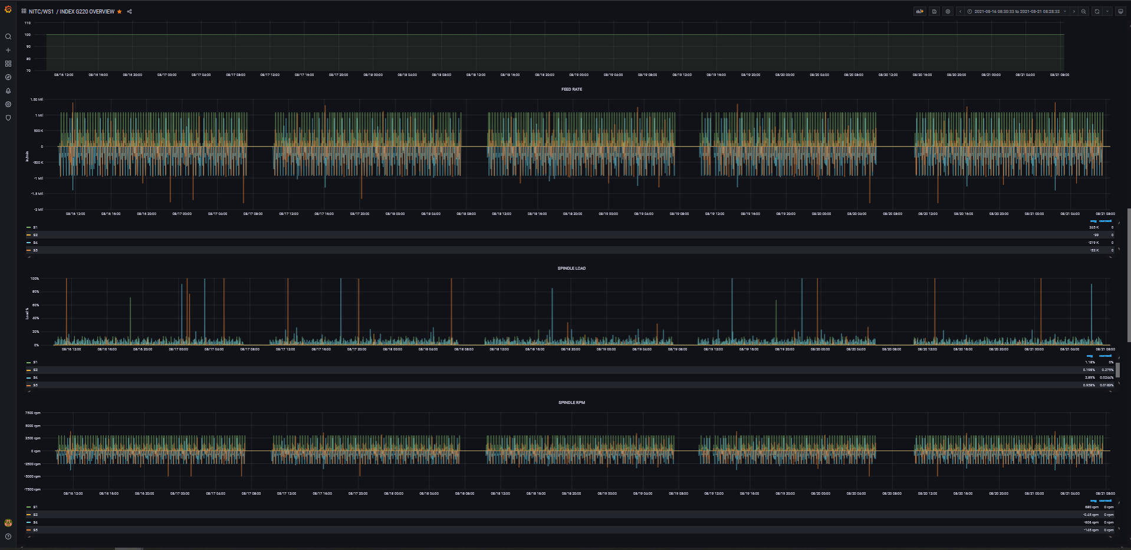
Methodology & Theory
Example dashboard (Grafana)

Slide 20
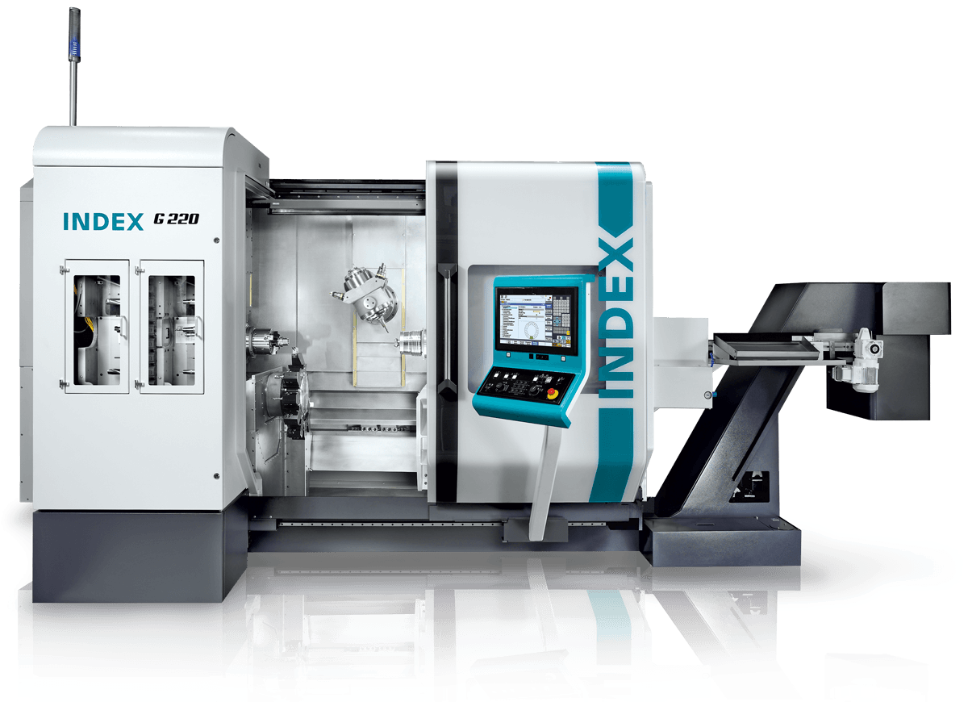
Methodology & Theory
Index G220

Slide 21
Results
Exploration

Slide 22
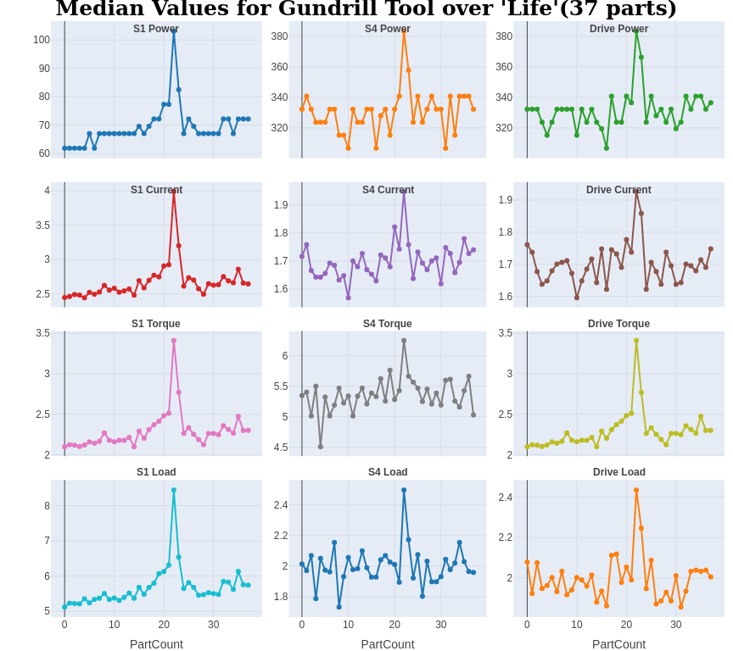
Results and Discussion
Spindle Selection

Slide 23
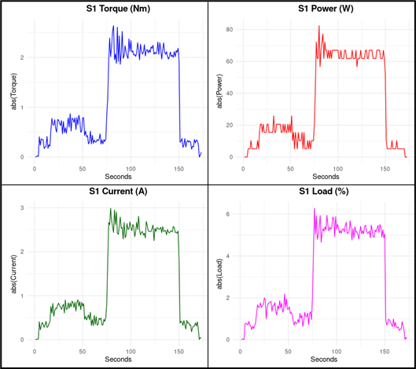
Results and Discussion
Parameter Selection

Slide 24
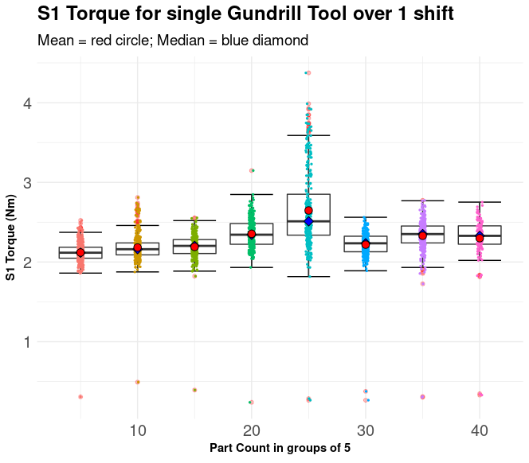
Results and Discussion
Parameter Spread

Slide 25
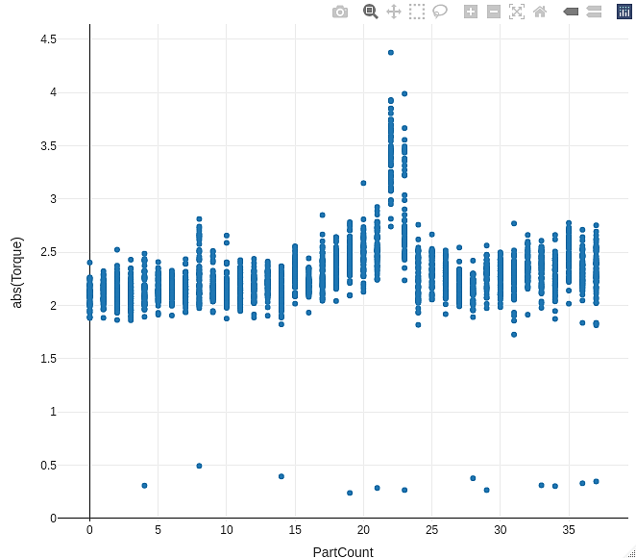
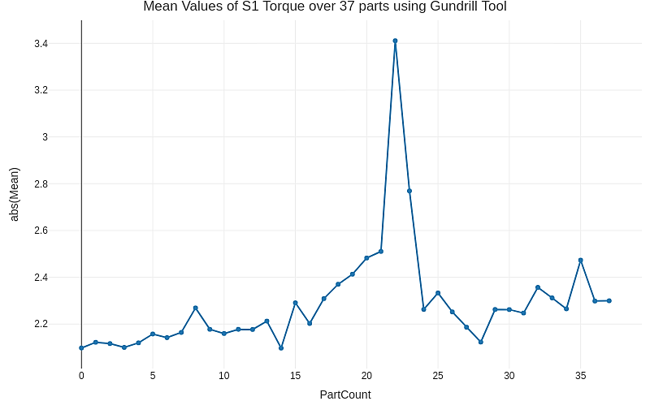
Results and Discussion
Parameter Analysis

Slide 26
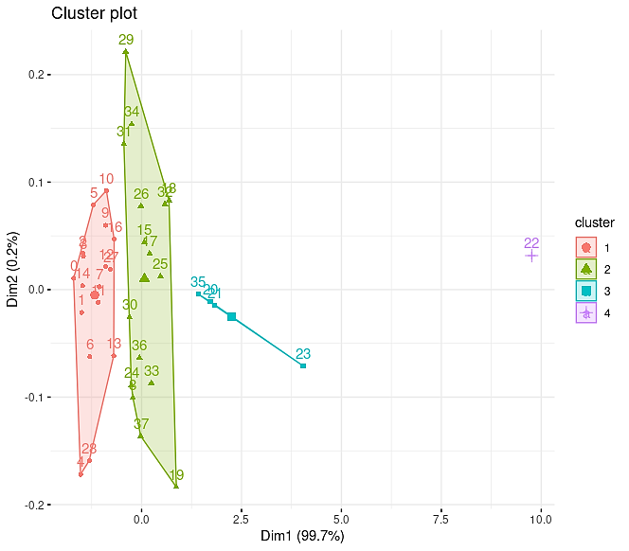
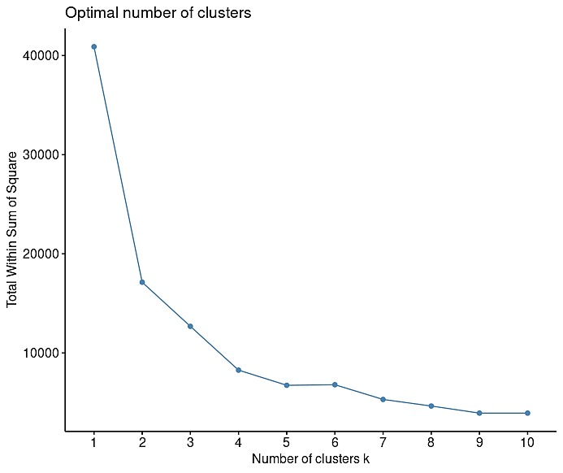
Results and Discussion
Cluster Analysis

Slide 27
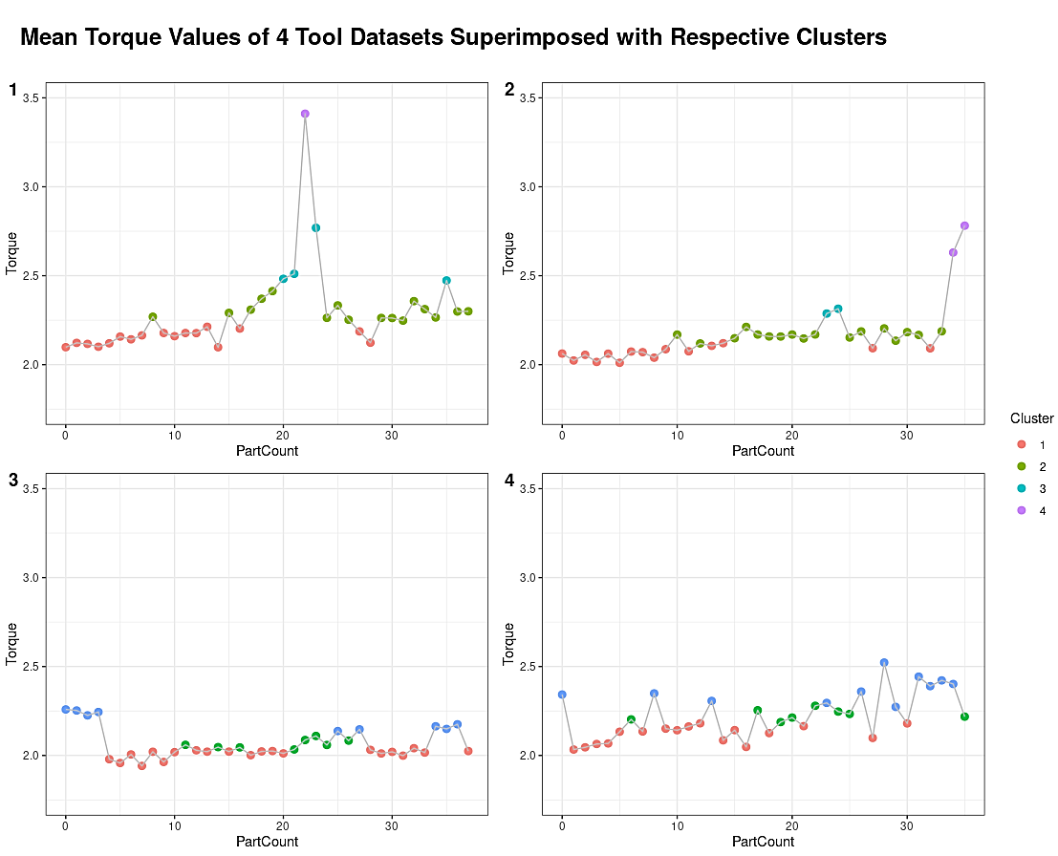
Results and Discussion
Cluster Analysis

Slide 28
Results
Modelling

Slide 29
Results and Discussion
Data prep
For all models, the data was first prepared.
Data was trimmed into 3 sections:
Training dataset which formed the bulk of the data (~70%)
Validation dataset which was used to assess model (20%)
Testing/Forecast dataset which was initially trimmed off the whole dataset and then used as ‘fake future’ data to test the forecast-ability of the models
Notes:
For all models, the data was first prepared by

Slide 30
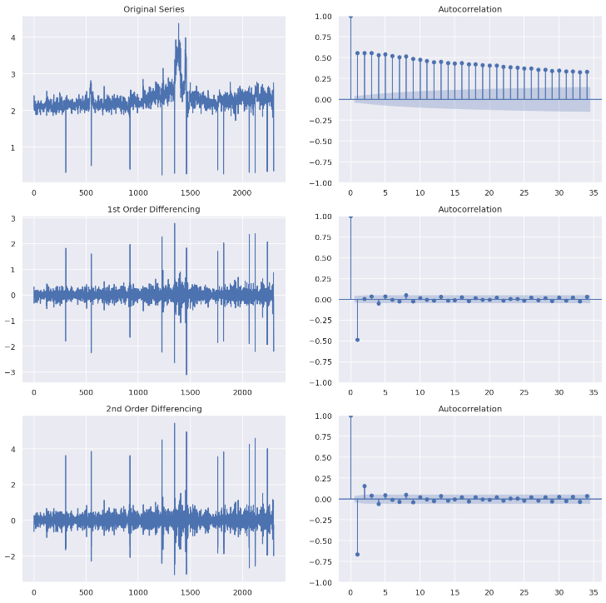
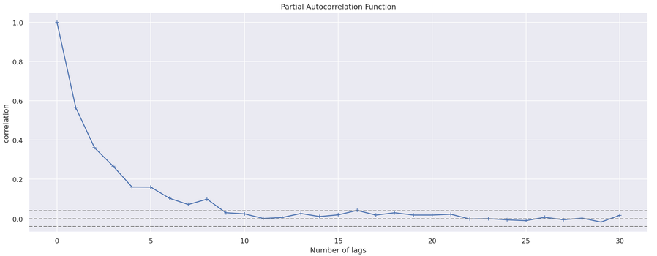
Results and Discussion
ARIMA
Notes:
For ARIMA, data needs to be stationary. This needed tested to confirm assumptions that it was

Slide 31
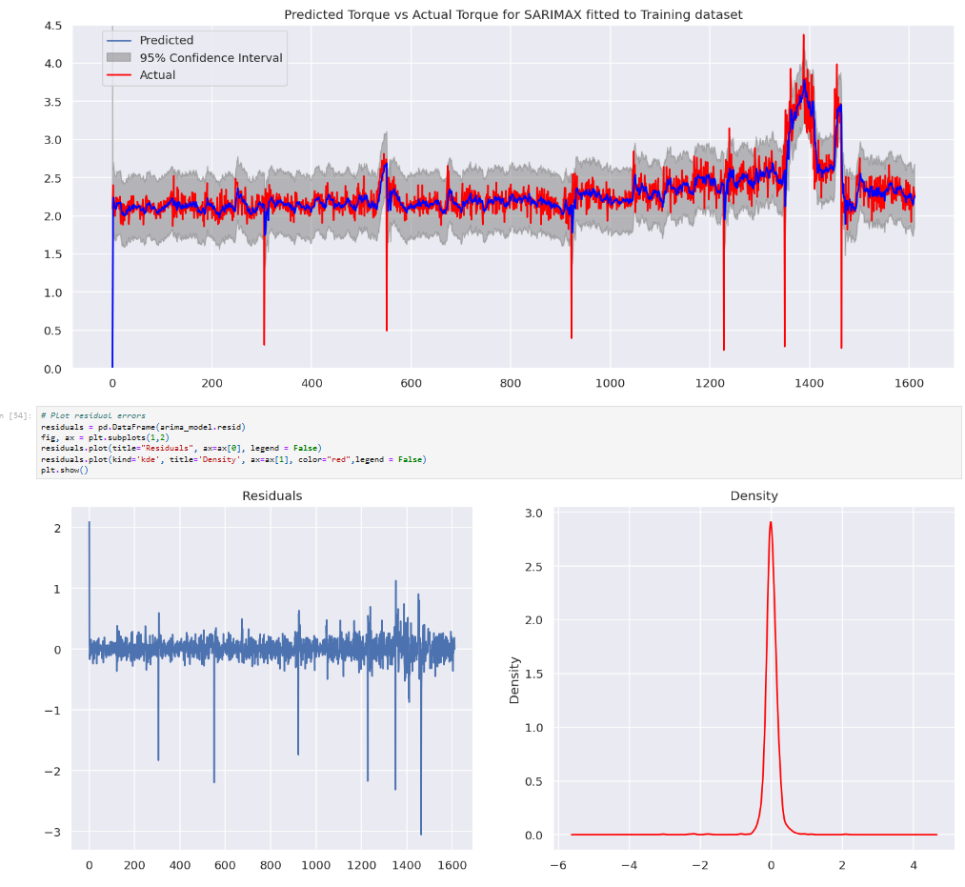
Results and Discussion
ARIMA

Slide 32
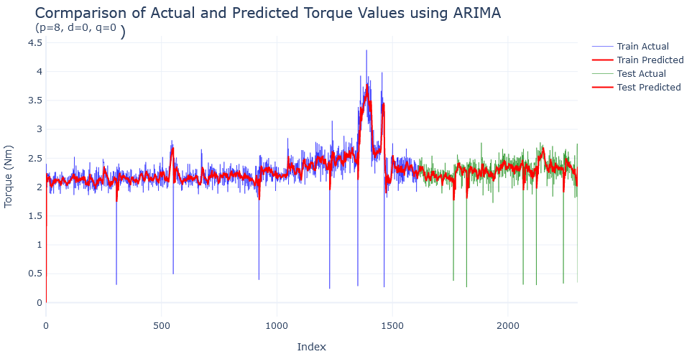
Results and Discussion
ARIMA

Slide 33
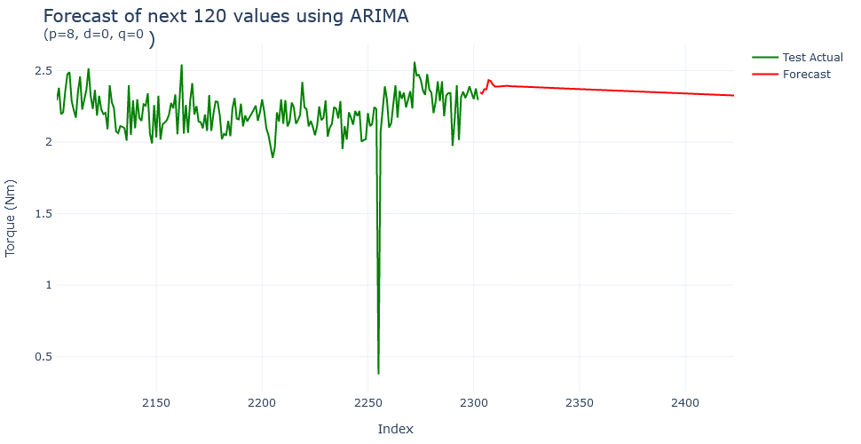
Results and Discussion
ARIMA

Slide 34
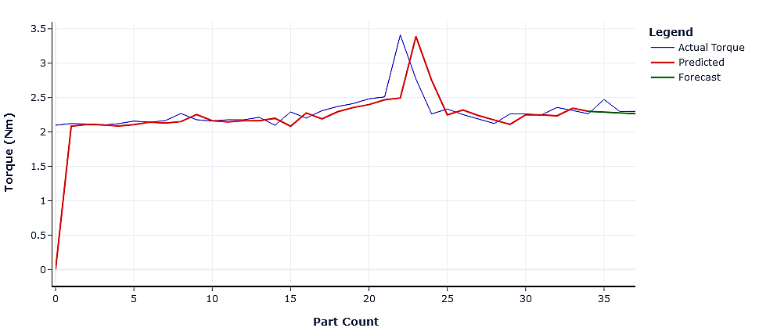
Results and Discussion
ARIMA
Actual vs Predicted Mean Torque Values per Part using ARIMA with Values 35-37 Forecasted
(p=1, d=0, q=0)

Slide 35
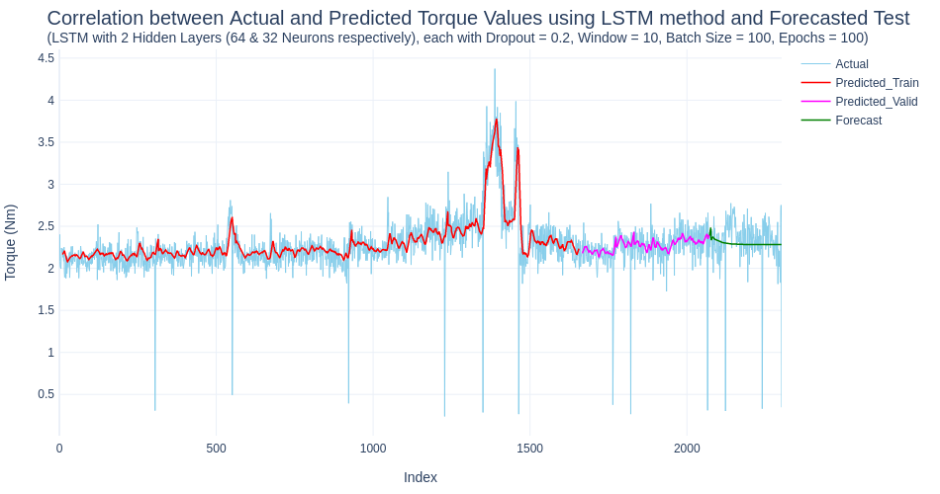
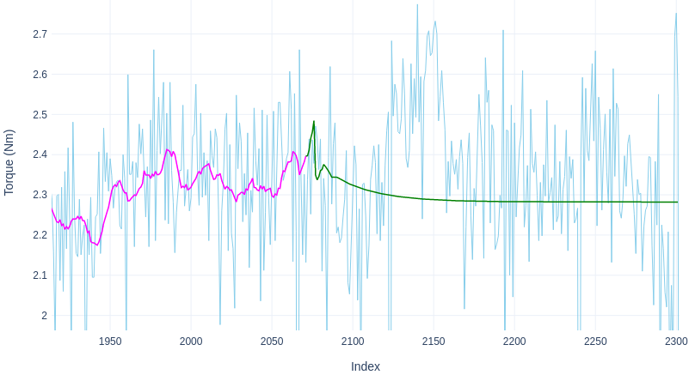
Results and Discussion
Neural Networks
Notes:
Applied similar methodology to LSTM, BiLSTM and GRU as well

Slide 36
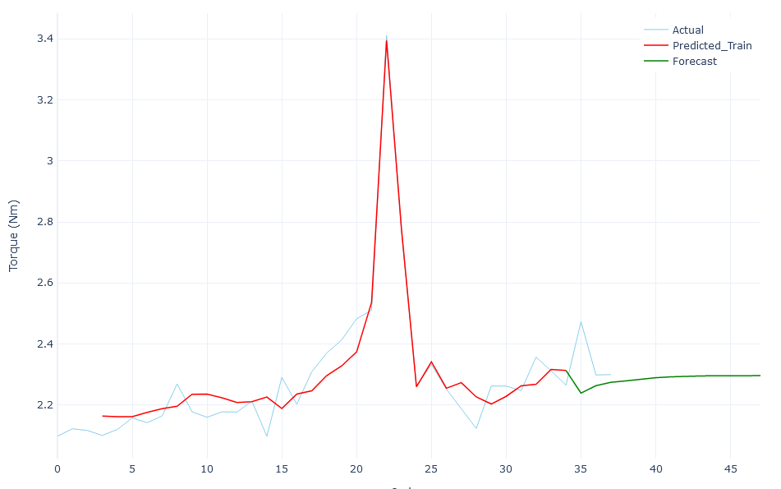
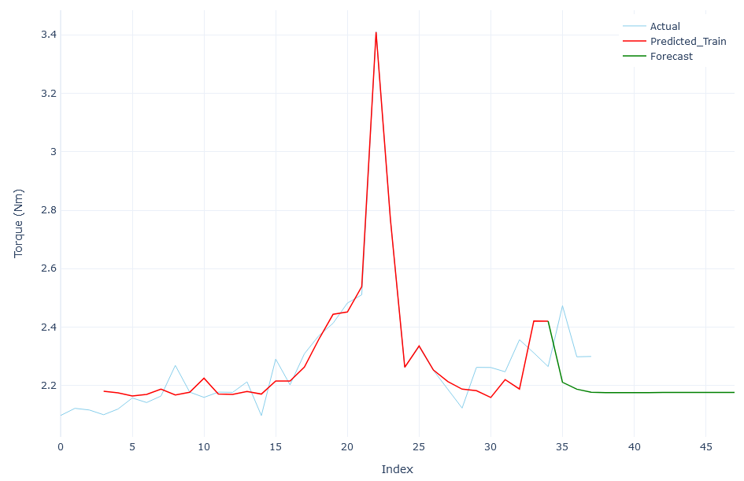
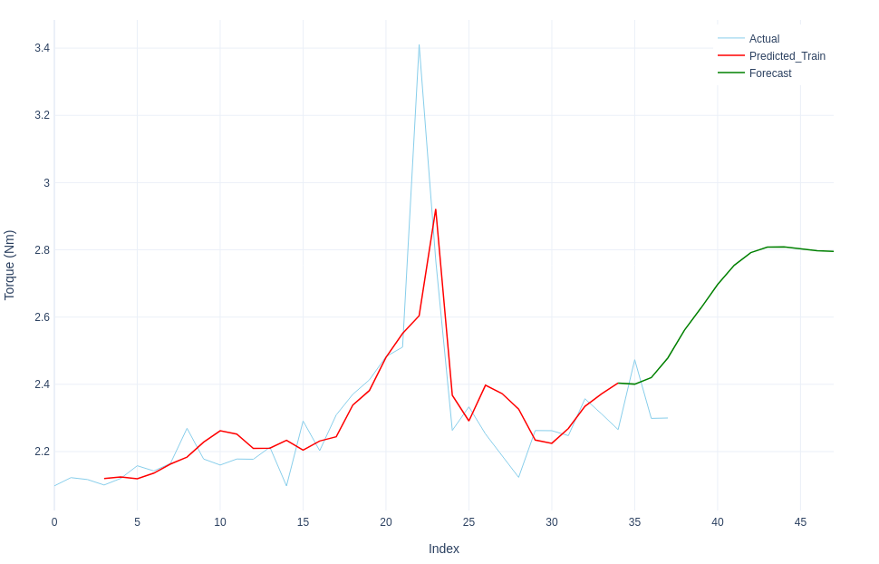
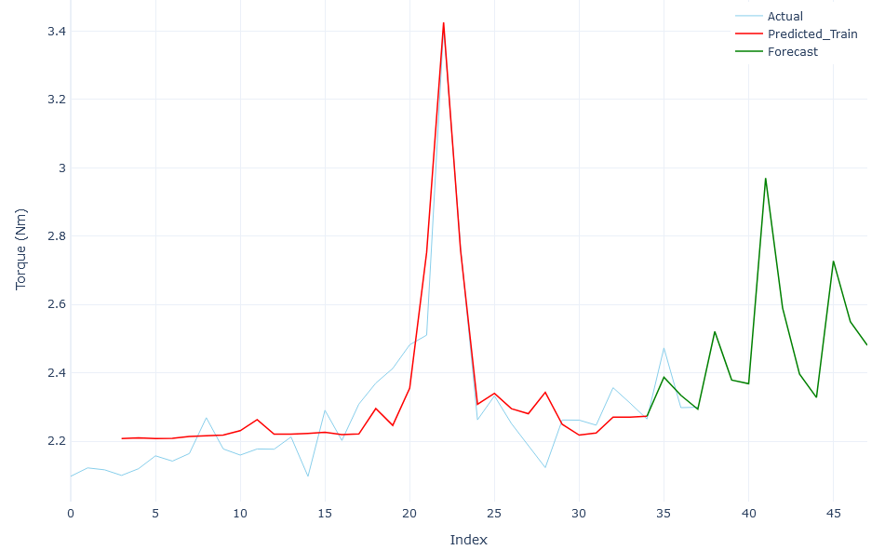
Results and Discussion
Neural Networks
LSTM
BiLSTM
GRU
GRU #2
Notes:
LSTM and BiLSTM didn’t do well at future forecasting but GRU seemed promising.
Through trial and error or retuning the hyperparamters, the GRU model showed much better results.

Slide 37
Results and Discussion
Hyperparameters

Slide 38
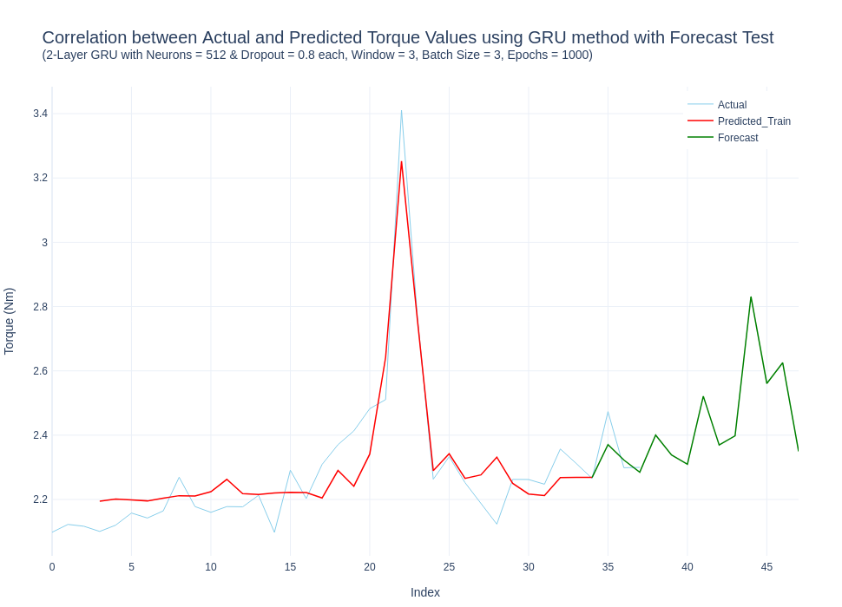
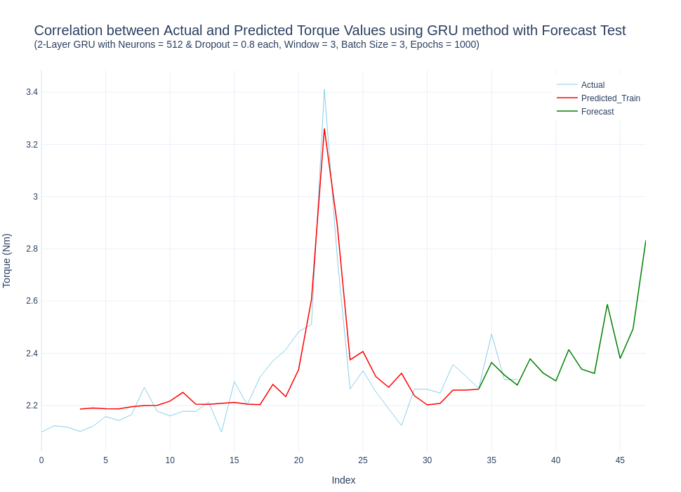
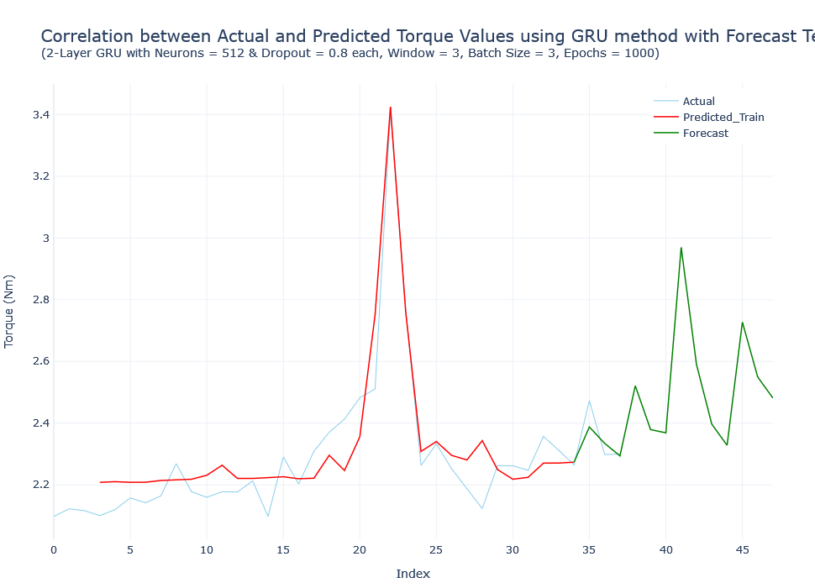
Results and Discussion
Reliability

Slide 39
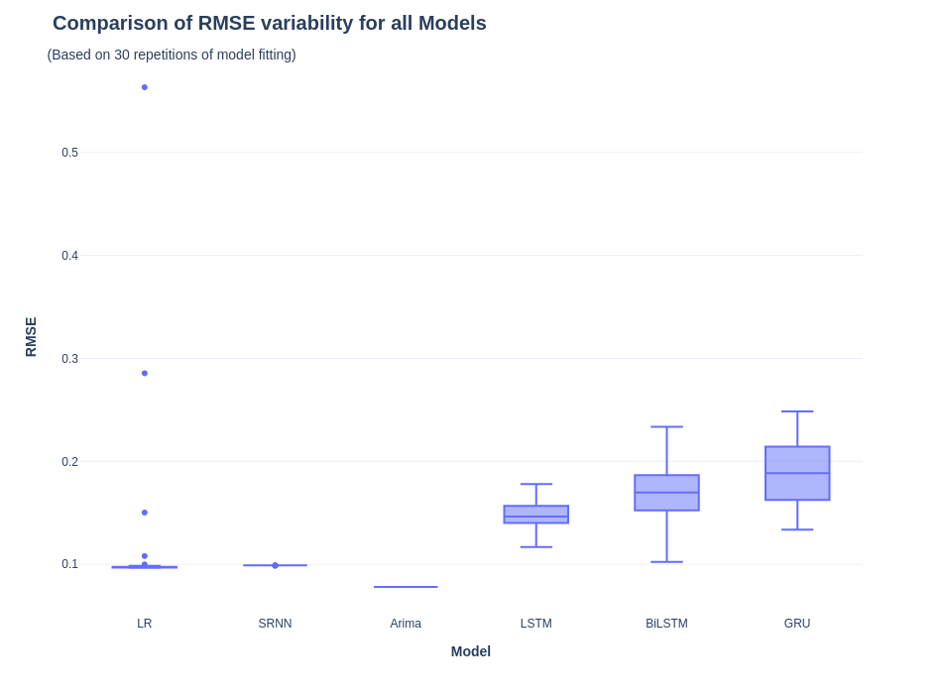
Results and Discussion
Repeatability

Slide 40
Results and Discussion
Summary of results
Notes:
GRU was over 50% better at forecasting than the others

Slide 41
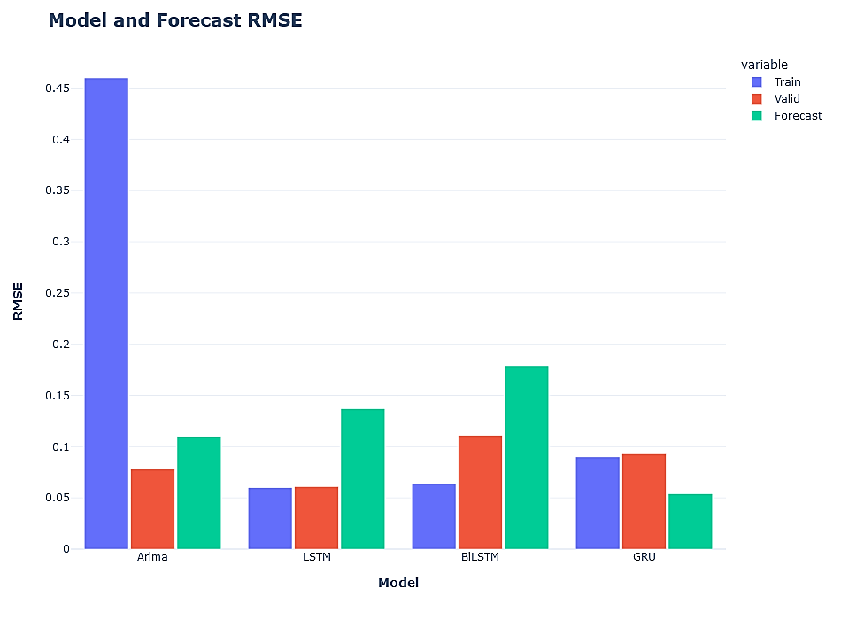
Results and Discussion
Summary of results

Slide 42
Conclusion
&
Future Work

Slide 43
Conclusion
The k-means cluster analysis performed on the mean Torque data offered a means of potentially being able to provide real time, on-line indications of classes of tool wear occurring and therefore a measurable means of evaluating effects of attempts at remedial action.
The results of the cluster analysis could also be used as a yard stick for comparison with other algorithms such as Random Forest
Comparing ARIMA, LSTM, BiLSTM and GRU for forecasting highlighted the need for better data formatting: raw data was too much for forecasting (10 seemed to be the max) and there was not enough data in the summarised dataset to allow the models to perform effectively.
The GRU model was deemed the best performer despite having the larger variation in results after 30 repeats. It offered the lowest forecast RMSE and offered the more probable result scenario when used to forecast further beyond the available dataset.
Notes:
The goal of this research was to explore a means of predicting future tool wear behaviour that would impact wear rate and life of the tool using low cost, open-source technologies, and real production data with an industry-adoptive focus.

Slide 44
Future Work
Implement a system of traceability so that parts identified by the clustering algorithm can be checked for indications of wear and associated types.
Examine tools with a microscope to build an image database to correlate with the production run data and to take dimensional measurements.
Repeat the research but using the contextual production data to create a multivariate dataset for the neural networks to utilise their unique ability to ‘learn’ and ‘memorise’ patterns.
Attempt further optimisation of the GRU model including transfer of model weights and vector outputs.

Slide 45
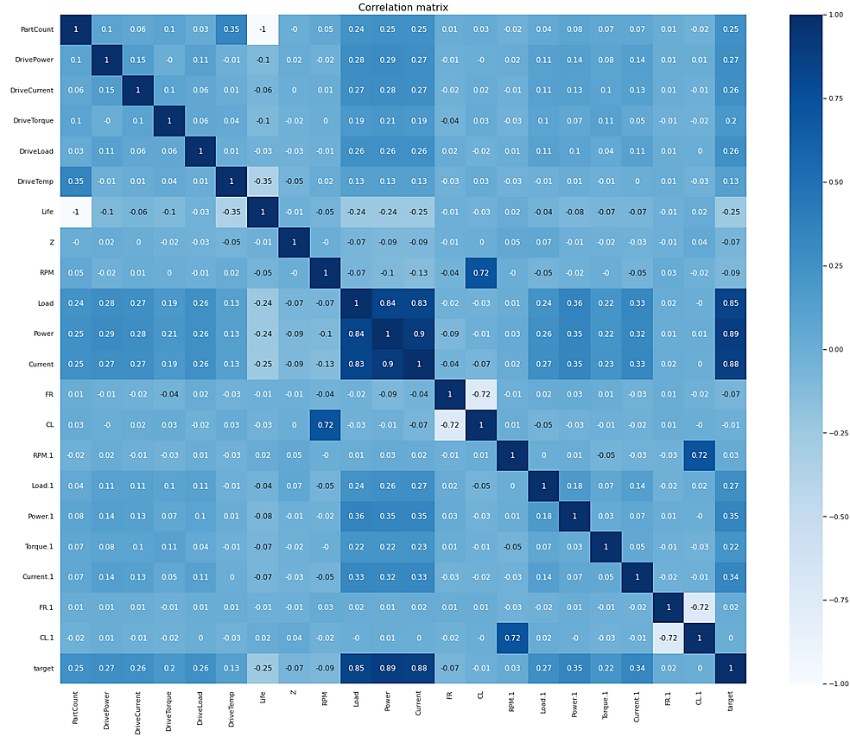
Future Work
Multivariate Analysis

Slide 46
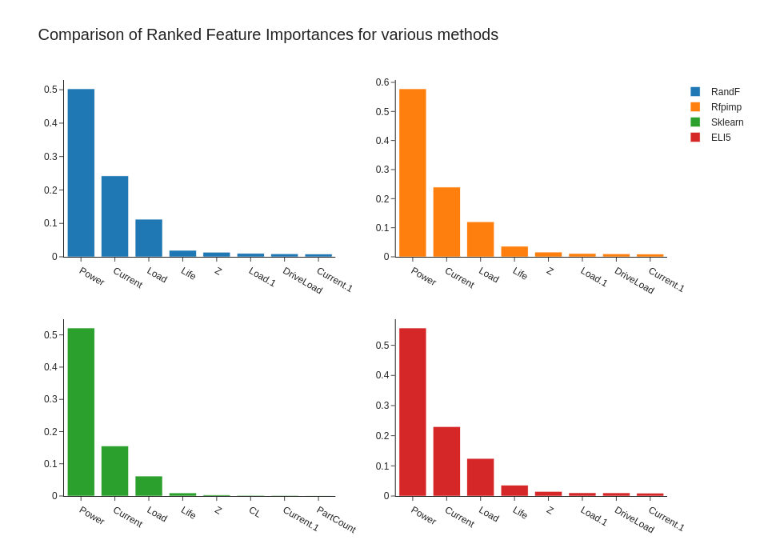
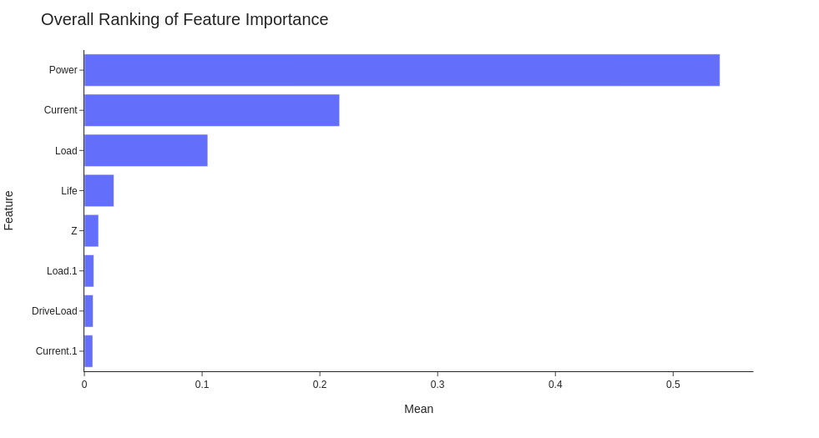
Future Work
Multivariate Analysis

Slide 47
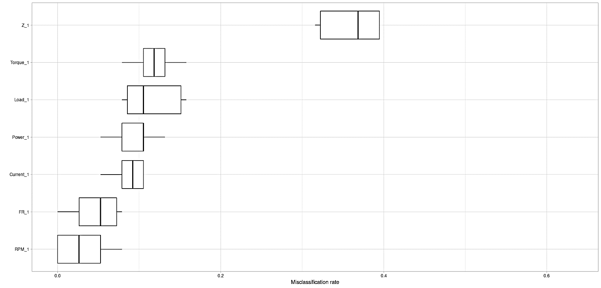
Future Work
Multivariate Analysis

Slide 48
Thank you.
Any Questions?

